Slide 1
Automatic mixed precision training
Michael Carilli
Notes:
Mixed precision training is critical to taking full advantage of the computational horsepower that Nvidia’s Tensor Core GPUs (Volta and Turing) provide.

Slide 2
Using mixed precision and Volta/Turing your networks can be:
2 – 4X faster
more memory-efficient
just as accurate
with no architecture or hyperparameter changes.
Notes:
What does that mean? Improved speed, reduced memory usage without impairing accuracy. The speed and memory benefits can alternatively enable you to try bigger batches or larger architectures.

Slide 3
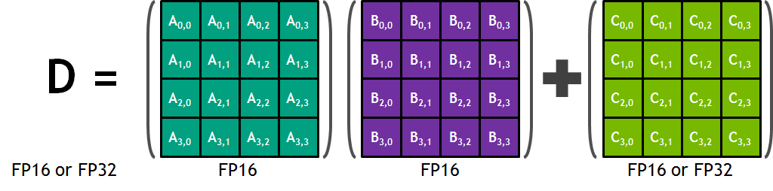
Maximizing model performance
FP16 input enables Volta/Turing Tensor Cores for Matrix Multiplies and Convolutions
125 TFlops Throughput: 8X more than FP32 on Volta V100
Notes:
Why is FP16 helpful to take full advantage of the hardware? More than just memory and bandwidth savings, specialized compute hardware for FP16 => more than 2X speedup possible for compute-bound networks like BERT.

Slide 4
Maximizing model performance
Assign each operation its optimal precision
FP16 with Tensor Cores
8X compute throughput
2X memory throughput
1/2X memory storage
FP32
Wider dynamic range
Increased precision captures small accumulations
ReLU
nn.Linear
Softmax
Loss
Notes:
Why mixed precision? Why use mixture of FP32 and FP16 ops? Accumulations, small + large values (optimizer updates), safety for ops that require a large dynamic range. By assigning each operation its optimal precision you get performance and stability. How well does it work in practice?

Slide 5
Mixed precision in practice: Speed
Mixed Precision vs. FP32
BERT 3.25X – 4.25X speedup* Jasper 2.2X – 3X speedup** Mask-RCNN 1.2X – 1.5X speedup† FAIRseq 4X speedup GNMT 2X speedup
* https://github.com/NVIDIA/DeepLearningExamples/tree/master/PyTorch/LanguageModeling/BERT ** https://github.com/NVIDIA/DeepLearningExamples/tree/master/PyTorch/SpeechRecognition/Jasper
† https://github.com/NVIDIA/DeepLearningExamples/tree/master/PyTorch/Segmentation/MaskRCNN
Notes:
Real observed speedups on a diversity of networks. Your observed speedup may vary depending on whether your network is compute bound or bandwidth bound, or affected by other constraints like dataloading.

Slide 6
Mixed precision in practice: accuracy
Same accuracy as FP32, with no hyperparameter changes
Model | FP32 | Mixed Precision*
AlexNet** | 56.77% | 56.93%
VGG-D | 65.40% | 65.43%
GoogLeNet (Inception v1) | 68.33% | 68.43%
Inception v2 | 70.03% | 70.02%
Inception v3 | 73.85% | 74.13%
Resnet50 | 75.92% | 76.04%
BERT Fine-Tuning† | 91.18% | 91.24%
* Same hyperparameters and learning rate schedule as FP32. ** Sharan Narang, Paulius Micikevicius et al., "Mixed Precision Training“, ICLR 2018 † https://github.com/NVIDIA/DeepLearningExamples/tree/master/PyTorch/LanguageModeling/BERT
Notes:
All the networks that we’ve worked on have converged to comparable accuracy with mixed precision and FP32. How can you realize this performance for your own network?

Slide 7
automatic mixed precision (AMP)
Existing FP32 (default) script -> Change 3 lines of Python -> Accelerate your training with mixed precision
Notes:
Automates mixed precision. Automatically assigns each operation its appropriate precision.

Slide 8
example
N, D_in, D_out = 64, 1024, 512
x = torch.randn(N, D_in, device=“cuda”)
y = torch.randn(N, D_out, device=“cuda”)
model = torch.nn.Linear(D_in, D_out).cuda()
optimizer = torch.optim.SGD(model.parameters(), lr=1e-3)
model, optimizer = amp.initialize(model, optimizer, opt_level=“O1”)
for t in range(500):
y_pred = model(x)
loss = torch.nn.functional.mse_loss(y_pred, y)
optimizer.zero_grad()
with amp.scale_loss(loss, optimizer) as scaled_loss:
scaled_loss.backward()
optimizer.step()
Notes:
These three lines enable mixed precision for your network. It’s easy to try.

Slide 9
Try amp today
Available through NVIDIA Apex utilities: https://github.com/nvidia/apex
Full API documentation: https://nvidia.github.io/apex/
Landing pages contain a link to this talk.
AMP Examples: https://github.com/NVIDIA/DeepLearningExamples
Notes:
Fully available today

Slide 10
Amp in pytorch core
Notes:
We’re not stopping there

Slide 11
Coming soon (target q4 2019)
Gradient scaling and autocasting as modular components
Intended support for networks that use:
JIT
multiple models/optimizers/losses
gradient accumulation
gradient checkpointing
gradient penalty (double-backward)
custom optimizers
Let us know what you need!
API discussion: https://github.com/pytorch/pytorch/issues/25081
Gradient scaling PR: https://github.com/pytorch/pytorch/pull/26512
Notes:
Actively working with Pytorch core developers to get native Pytorch support for automatic mixed precision. We’re keeping a close eye on support for complex networks and use cases.

